Slide 1
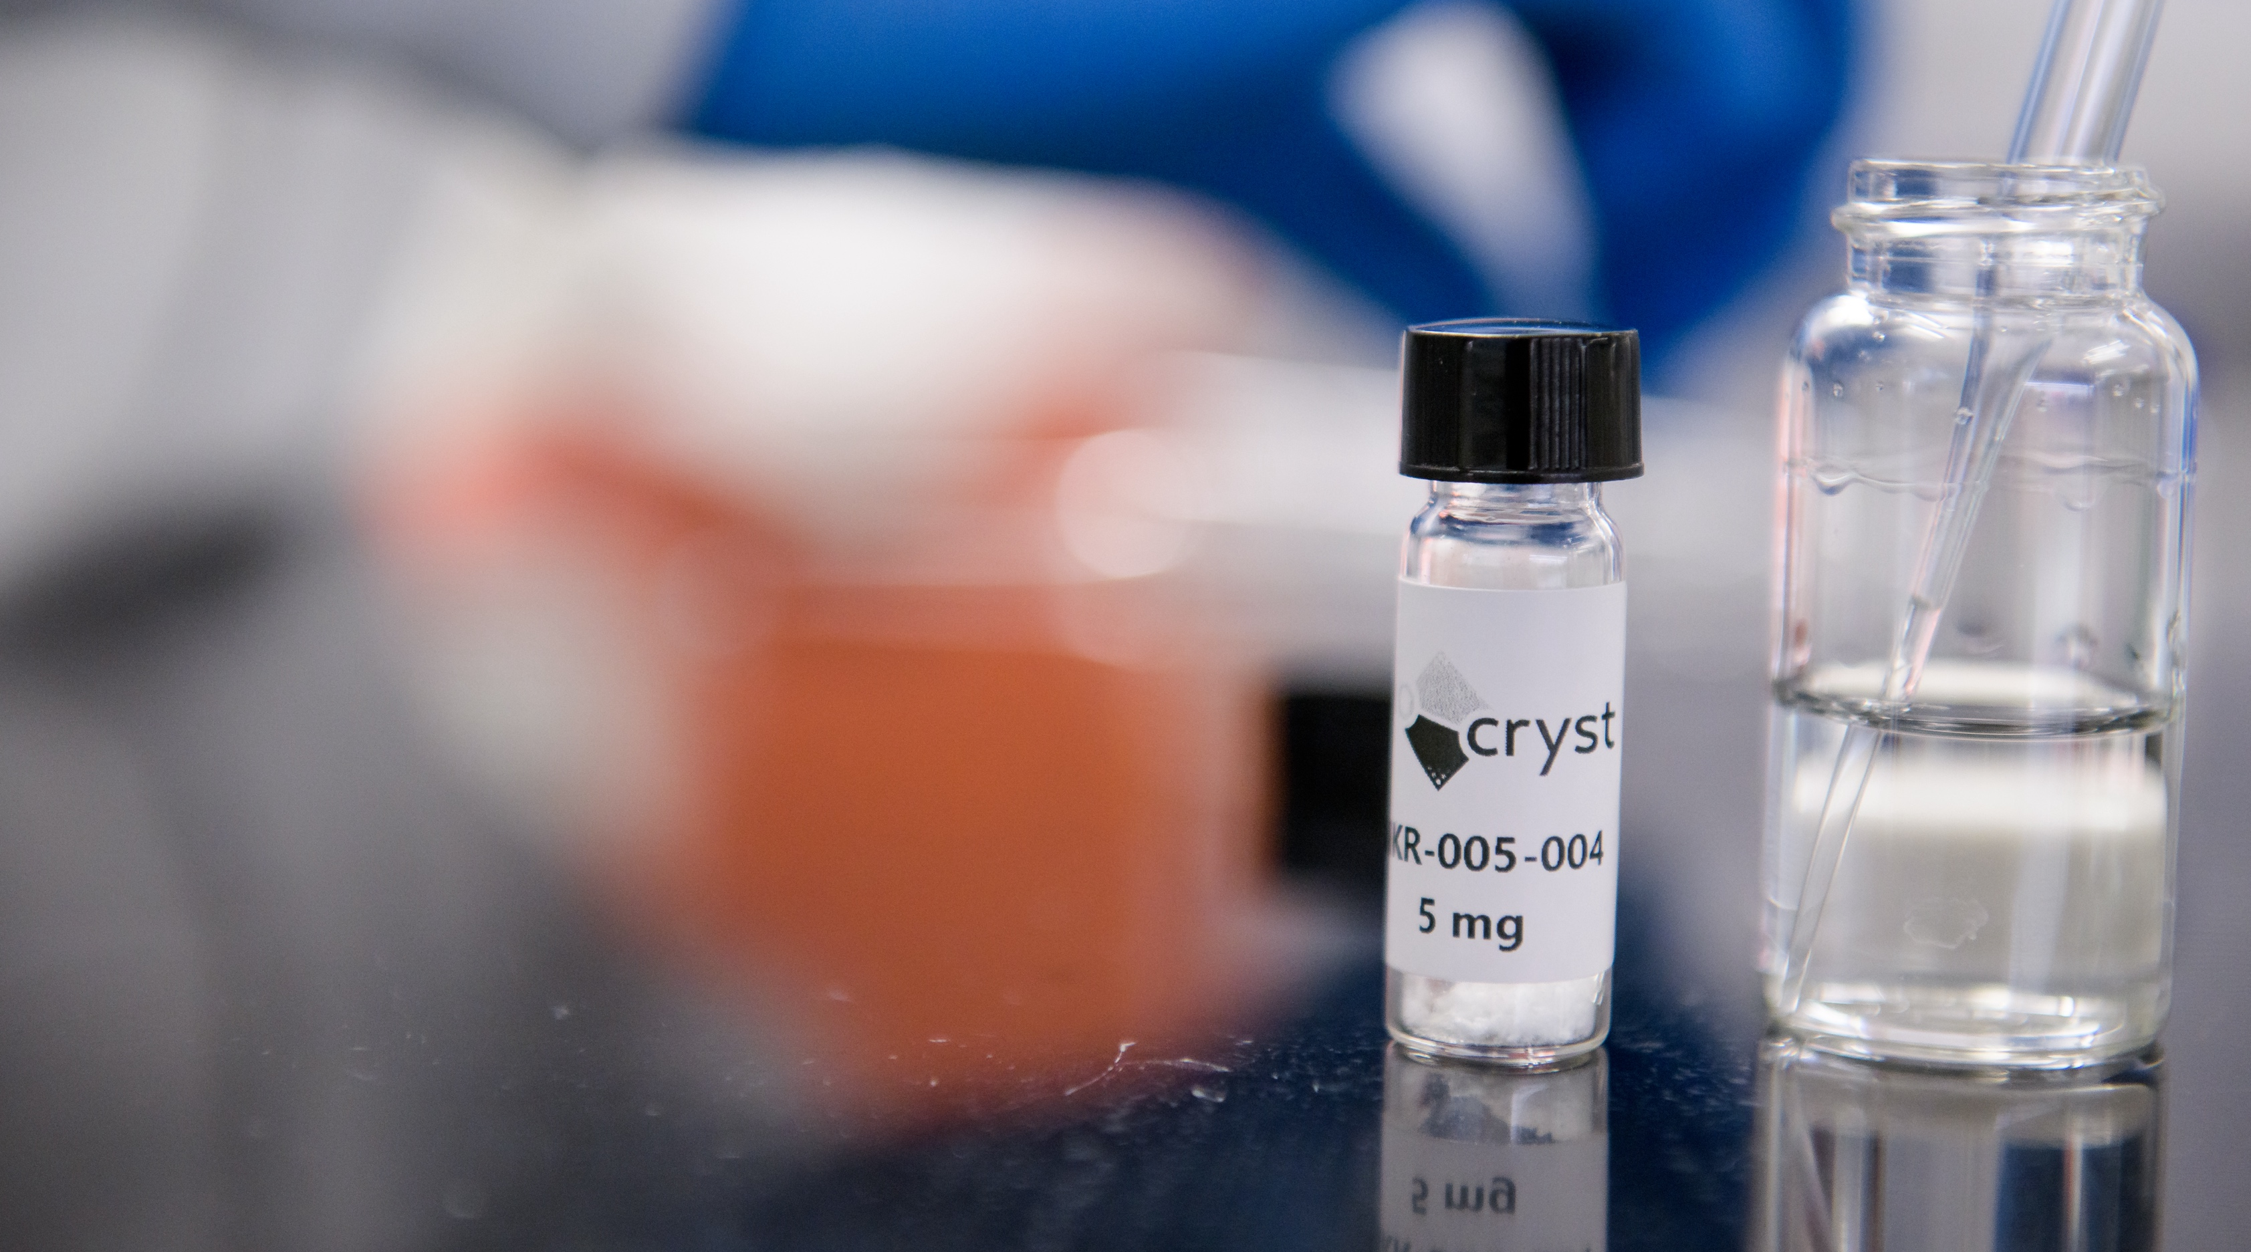


Berotralstat FDA Adverse Event Reporting System (FAERS) analysis
INITIAL ANALYSES
Kim Glenn, PhD, MPH
Frances Carr, MBA, MSPA
July 15, 2024
CONFIDENTIAL & PROPRIETARY

Slide 2
Attrition Table
Descriptive Analysis Summary
Logistic Regressions: Lack of Efficacy
Logistic Regressions: Angioedema
Logistic Regressions: Swelling
Logistic Regressions: Composite Reaction
MedDRA Reactions Terms List
Project Timeline Review & Next Steps
CONFIDENTIAL & PROPRIETARY

Slide 3
ATTRITION AND DESCRIPTIVE ANALYSIS
Attrition table and
descriptive analysis summary
CONFIDENTIAL & PROPRIETARY

Slide 4
Attrition Table

Slide 5
Descriptive Analysis Summary
HIGH-LEVEL TAKEAWAYS
Age was highly missing for all LTP products (minimum of 14.2% missingness) and sex was missing in 43.5% of ORLEDAYO® (berotralstat) reports
TAKHZYRO® (lanadelumab) and CINRYZE®’s reporting population were younger than the reporting populations for other products (40.1 and 40.8 years old)
On average, approximately 77% of the ADR reports across all products were concerning female patients
It was not possible to adequately examine the impact of the duration of therapy on the reporting risk for any product of interest due to high missingness (11.4% for start date of therapy; 97.4% for end date of therapy)
Most ORLEDAYO® (56.5%) reports were consumer-reported (the highest proportion observed among all LTP products)
Overall, most ADRs of interest were reported by consumers, health care professionals, and physicians
Over three-quarters of ADR-of-interest reports for TAKHZYRO® and C1 esterase inhibitors were related to lack of efficacy, while over most for ORLEDAYO® were related to swelling.

Slide 6
REGRESSION ANALYSES
Initial logistic regression analyses: Lack of efficacy
CONFIDENTIAL & PROPRIETARY

Slide 7

Risk of HAE ADR Reports among LTP Products of Interest
LACK OF EFFICACY
HAE Product | Reporting Odds Ratio | p-value | 95% Confidence Interval
ORLEDAYO® (berotralstat) (referent) | - | - | - | -
TAKHZYRO® (lanadelumab) | 0.78 | 0.245 | 0.52 | 1.21
CINRYZE® | 0.55 | 0.008** | 0.36 | 0.87
HAEGARDA® | 0.25 | <0.001*** | 0.17 | 0.39
C1 Esterase Inhibitor (NS)# | 1.37 | 0.154 | 0.9 | 2.15
Significance codes: 0.001 ‘***’, 0.05 ‘**’, 0.10 ‘*’
CINRYZE® and HAEGARDA® are significantly less likely to be named as the primary suspect for lack of efficacy adverse events than ORLEDAYO®.
CONFIDENTIAL & PROPRIETARY

Slide 8
Risk of HAE ADR Reports among LTP Products of Interest
LACK OF EFFICACY – COMBINED C1 ESTERASE INHIBITORS
HAE Product | Reporting Odds Ratio | p-value | 95% Confidence Interval
ORLEDAYO® (berotralstat) (referent) | - | - | - | -
TAKHZYRO® (lanadelumab) | 0.78 | 0.245 | 0.52 | 1.21
C1 Esterase Inhibitors | 0.36 | <0.001*** | 0.24 | 0.56
Significance codes: 0.001 ‘***’, 0.05 ‘**’, 0.10 ‘*’
CINRYZE® and HAEGARDA® are significantly less likely to be named as the primary suspect for lack of efficacy adverse events than ORLEDAYO®.
CONFIDENTIAL & PROPRIETARY

Slide 9
Risk of HAE ADR Reports among LTP Products of Interest -
Adjusted for Time Since FDA Approval (from Report Date)
LACK OF EFFICACY
HAE Product | Reporting Odds Ratio | p-value | 95% Confidence Interval
ORLEDAYO® (berotralstat) (referent) | - | - | - | -
TAKHZYRO® (lanadelumab) | 1.08 | 0.727 | 0.72 | 1.68
CINRYZE® | 1.27 | 0.315 | 0.81 | 2.04
HAEGARDA® | 0.41 | <0.001*** | 0.27 | 0.64
C1 Esterase Inhibitor (NS)^{# +} | 5.08 | <0.001*** | 3.12 | 8.49
Time Since FDA Approval (Years)^ | 0.85 | <0.001*** | 0.82 | 0.88
Significance codes: 0.001 ‘***’, 0.05 ‘**’, 0.10 ‘*’
Compared to ORLEDAYO®, HAEGARDA® is 60% less likely to be named as the primary suspect on a report of lack of efficacy after controlling for the time on the market. Of note, the C1 esterase inhibitors named without a specified brand were more than 5 times more likely to be named in as a primary suspect in a lack of efficacy report.
CONFIDENTIAL & PROPRIETARY

Slide 10
Risk of HAE ADR Reports among LTP Products of Interest -
Adjusted for Time Since FDA Approval (from Report Date)
LACK OF EFFICACY – COMBINED C1 ESTERASE INHIBITORS
HAE Product | Reporting Odds Ratio | p-value | 95% Confidence Interval
ORLEDAYO® (berotralstat) (referent) | - | - | - | -
TAKHZYRO® (lanadelumab) | 0.69 | 0.0813 | 0.46 | 1.07
C1 Esterase Inhibitors | 0.29 | <0.001*** | 0.19 | 0.45
Time Since FDA Approval (Years)^ | 1.06 | <0.001*** | 1.03 | 1.09
Significance codes: 0.001 ‘***’, 0.05 ‘**’, 0.10 ‘*’
Compared to ORLEDAYO®, C1 esterase inhibitors were 70% less likely to be named as the primary suspect on a report of lack of efficacy after controlling for the time on the market.
CONFIDENTIAL & PROPRIETARY

Slide 11
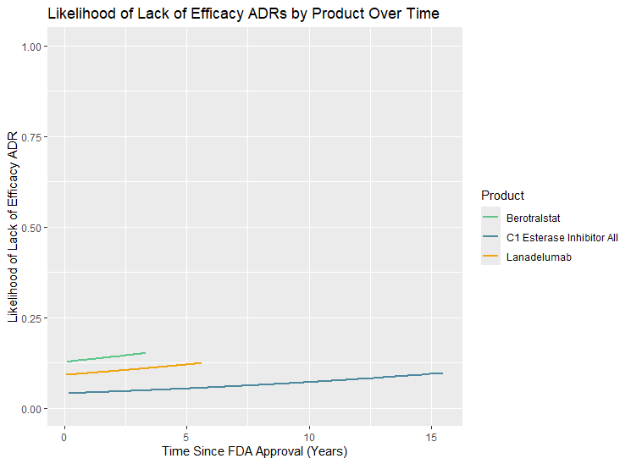
Risk of HAE ADR Reports among LTP Products of Interest -
Adjusted for Time Since FDA Approval (from Report Date)
LACK OF EFFICACY – COMBINED C1 ESTERASE INHIBITORS
The likelihood of a report for lack of efficacy increases slightly over time the longer the product is on the market.
CONFIDENTIAL & PROPRIETARY
- More information on the likelihood of ADR scale in Technical Notes slides

Slide 12
REGRESSION ANALYSES
Initial logistic regression analyses: Angioedema
CONFIDENTIAL & PROPRIETARY

Slide 13

Risk of HAE ADR Reports among LTP Products of Interest
ANGIOEDEMA
HAE Product | Reporting Odds Ratio | p-value | 95% Confidence Interval
ORLEDAYO® (berotralstat) (referent) | - | - | - | -
TAKHZYRO® (lanadelumab) | 6.34 | <0.001*** | 4.66 | 8.73
CINRYZE® | 2.24 | <0.001*** | 1.64 | 3.10
HAEGARDA® | 21.74 | <0.001*** | 16.01 | 29.89
C1 Esterase Inhibitor (NS)# | 2.87 | <0.001*** | 2.08 | 4.00
Significance codes: 0.001 ‘***’, 0.05 ‘**’, 0.10 ‘*’
All other products of interest were significantly more likely to be named as the primary suspect in an angioedema adverse event report than ORLEDAYO®.
CONFIDENTIAL & PROPRIETARY

Slide 14
Risk of HAE ADR Reports among LTP Products of Interest
ANGIOEDEMA – COMBINED C1 ESTERASE INHIBITORS
HAE Product | Reporting Odds Ratio | p-value | 95% Confidence Interval
ORLEDAYO® (berotralstat) (referent) | - | - | - | -
TAKHZYRO® (lanadelumab) | 6.34 | <0.001*** | 4.66 | 8.73
C1 Esterase Inhibitors | 11.01 | <0.001*** | 8.13 | 15.09
Significance codes: 0.001 ‘***’, 0.05 ‘**’, 0.10 ‘*’
All other products of interest were significantly more likely to be named as the primary suspect in an angioedema adverse event report than ORLEDAYO®.
CONFIDENTIAL & PROPRIETARY

Slide 15
Risk of HAE ADR Reports among LTP Products of Interest -
Adjusted for Time Since FDA Approval (from Report Date)
ANGIOEDEMA
HAE Product | Reporting Odds Ratio | p-value | 95% Confidence Interval
ORLEDAYO® (berotralstat) (referent) | - | - | - | -
TAKHZYRO® (lanadelumab) | 4.35 | <0.001*** | 3.18 | 6.00
CINRYZE® | 0.78 | 0.161 | 0.56 | 1.11
HAEGARDA® | 12.55 | <0.001*** | 9.18 | 17.35
C1 Esterase Inhibitor (NS)^{# +} | 0.59 | 0.005** | 0.41 | 0.86
Time Since FDA Approval (Years)^ | 1.21 | <0.001*** | 1.19 | 1.24
Significance codes: 0.001 ‘***’, 0.05 ‘**’, 0.10 ‘*’
Compared to ORLEDAYO® , TAKHZYRO® and HAEGARDA® were significantly more likely to be named as the primary suspect in angioedema reports, controlling for the time on market. C1 esterase inhibitors named without a specified brand were significantly less likely than ORLEDAYO ® to be the primary suspect in an angioedema-related ADR.
CONFIDENTIAL & PROPRIETARY

Slide 16
Risk of HAE ADR Reports among LTP Products of Interest -
Adjusted for Time Since FDA Approval (from Report Date)
ANGIOEDEMA – COMBINED C1 ESTERASE INHIBITORS
HAE Product | Reporting Odds Ratio | p-value | 95% Confidence Interval
ORLEDAYO® (berotralstat) (referent) | - | - | - | -
TAKHZYRO® (lanadelumab) | 8.19 | <0.001*** | 6.00 | 11.30
C1 Esterase Inhibitor (NS)^{# +} | 17.72 | <0.001*** | 12.97 | 24.49
Time Since FDA Approval (Years)^ | 0.89 | <0.001*** | 0.87 | 0.90
Significance codes: 0.001 ‘***’, 0.05 ‘**’, 0.10 ‘*’
Compared to ORLEDAYO® and after adjustment for time on the market, TAKHZYRO® and C1 esterase inhibitors were significantly more likely to be named as the primary suspect in angioedema reports.
CONFIDENTIAL & PROPRIETARY

Slide 17
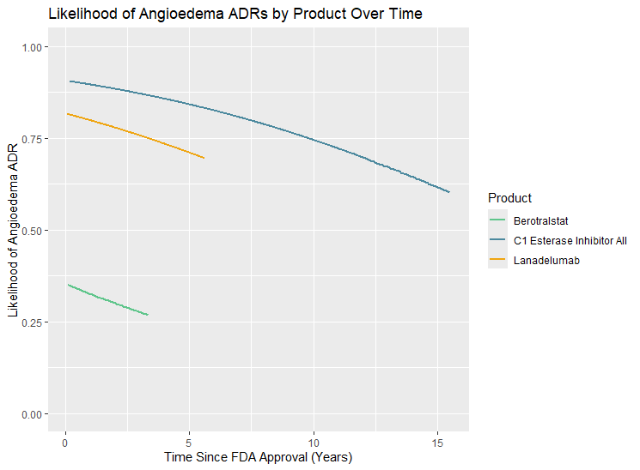
Risk of HAE ADR Reports among LTP Products of Interest -
Adjusted for Time Since FDA Approval (from Report Date)
ANGIOEDEMA – COMBINED C1 ESTERASE INHIBITORS
The likelihood of an angioedema ADR decreases over time the longer the product is on the market.
CONFIDENTIAL & PROPRIETARY
- More information on the likelihood of ADR scale in Technical Notes slides

Slide 18
REGRESSION ANALYSES
Initial logistic regression analyses: Swelling
CONFIDENTIAL & PROPRIETARY

Slide 19

Risk of HAE ADR Reports among LTP Products of Interest
SWELLING
• Bullets here for supporting points
• Supporting point 1
• Supporting point 2
• Supporting point 3
HAE Product | Reporting Odds Ratio | p-value | 95% Confidence Interval
ORLEDAYO® (berotralstat) (referent) | - | - | - | -
TAKHZYRO® (lanadelumab) | 0.14 | <0.001*** | 0.11 | 0.19
CINRYZE® | 0.58 | <0.001*** | 0.43 | 0.79
HAEGARDA® | 0.05 | <0.001*** | 0.03 | 0.06
C1 Esterase Inhibitor (NS)# | 0.28 | <0.001*** | 0.21 | 0.38
Significance codes: 0.001 ‘***’, 0.05 ‘**’, 0.10 ‘*’
All other products are significantly less likely to be the primary suspect in a swelling-related adverse event report than ORLADEYO®.
CONFIDENTIAL & PROPRIETARY

Slide 20
Risk of HAE ADR Reports among LTP Products of Interest
SWELLING – COMBINED C1 ESERASE INHIBITORS
• Bullets here for supporting points
• Supporting point 1
• Supporting point 2
• Supporting point 3
HAE Product | Reporting Odds Ratio | p-value | 95% Confidence Interval
ORLEDAYO® (berotralstat) (referent) | - | - | - | -
TAKHZYRO® (lanadelumab) | 0.14 | <0.001*** | 0.11 | 0.19
C1 Esterase Inhibitors | 0.10 | <0.001*** | 0.08 | 0.19
Significance codes: 0.001 ‘***’, 0.05 ‘**’, 0.10 ‘*’
All other products are significantly less likely to be the primary suspect in a swelling-related adverse event report than ORLADEYO®.
CONFIDENTIAL & PROPRIETARY

Slide 21
Risk of HAE ADR Reports among LTP Products of Interest -
Adjusted for Time Since FDA Approval (from Report Date)
SWELLING
• Bullets here for supporting points
• Supporting point 1
• Supporting point 2
• Supporting point 3
HAE Product | Reporting Odds Ratio | p-value | 95% Confidence Interval
ORLEDAYO® (berotralstat) (referent) | - | - | - | -
TAKHZYRO® (lanadelumab) | 0.20 | <0.001*** | 0.15 | 0.26
CINRYZE® | 1.39 | 0.045** | 1.01 | 1.93
HAEGARDA® | 0.07 | <0.001*** | 0.55 | 0.10
C1 Esterase Inhibitor (NS)^{# +} | 1.05 | 0.809 | 0.72 | 1.51
Time Since FDA Approval (Years)^ | 0.85 | <0.001*** | 0.83 | 0.87
Significance codes: 0.001 ‘***’, 0.05 ‘**’, 0.10 ‘*’
Compared to ORLEDAYO®, TAKHZRYO® and HAEGARDA® were significantly less likely to be named as the primary suspect on a swelling-related report after controlling for the time on the market. Conversely, CINRYZE® was 39% more likely to be named as a primary suspect in a lack of efficacy report.
CONFIDENTIAL & PROPRIETARY

Slide 22
Risk of HAE ADR Reports among LTP Products of Interest -
Adjusted for Time Since FDA Approval (from Report Date)
SWELLING – COMBINED C1 ESTERASE INHIBITORS
• Bullets here for supporting points
• Supporting point 1
• Supporting point 2
• Supporting point 3
HAE Product | Reporting Odds Ratio | p-value | 95% Confidence Interval
ORLEDAYO® (berotralstat) (referent) | - | - | - | -
TAKHZYRO® (lanadelumab) | 0.11 | <0.001*** | 0.08 | 0.14
C1 Esterase Inhibitors | 0.06 | <0.001*** | 0.05 | 0.08
Time Since FDA Approval (Years)^ | 0.85 | <0.001*** | 0.83 | 0.87
Significance codes: 0.001 ‘***’, 0.05 ‘**’, 0.10 ‘*’
Compared to ORLEDAYO®, TAKHZYRO® and C1 esterase inhibitors are significantly less likely to be named as the primary suspect on a swelling-related report after controlling for the time on the market.
CONFIDENTIAL & PROPRIETARY

Slide 23
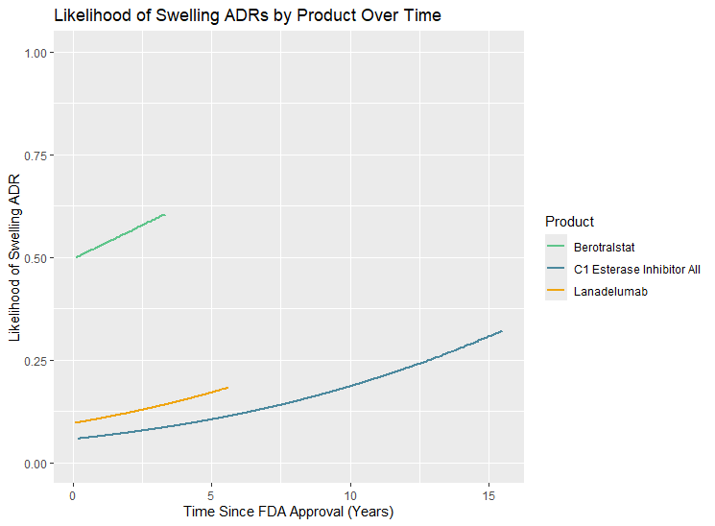
Risk of HAE ADR Reports among LTP Products of Interest -
Adjusted for Time Since FDA Approval (from Report Date)
SWELLING – COMBINED C1 ESTERASE INHIBITORS
• Bullets here for supporting points
• Supporting point 1
• Supporting point 2
• Supporting point 3
The likelihood of a swelling-related ADR report increases the longer the product is on the market.
CONFIDENTIAL & PROPRIETARY
- More information on the likelihood of ADR scale in Technical Notes slides

Slide 24
REGRESSION ANALYSES
Initial logistic regression analyses: Composite Outcome
CONFIDENTIAL & PROPRIETARY

Slide 25

Risk of HAE ADR Reports among LTP Products of Interest
COMPOSITE ADR
• Bullets here for supporting points
• Supporting point 1
• Supporting point 2
• Supporting point 3
HAE Product | Reporting Odds Ratio | p-value | 95% Confidence Interval
ORLEDAYO® (berotralstat) (referent) | - | - | - | -
TAKHZYRO® (lanadelumab) | 0.57 | <0.001*** | 0.48 | 0.68
CINRYZE® | 1.21 | 0.045** | 1.01 | 1.45
HAEGARDA® | 2.70 | <0.001*** | 2.28 | 3.22
C1 Esterase Inhibitor (NS)# | 0.56 | <0.001*** | 0.47 | 0.68
Significance codes: 0.001 ‘***’, 0.05 ‘**’, 0.10 ‘*’
CINRYZE® and HAEGARDA® are significantly more likely to be the primary suspect in an ADR rreport for lack of efficacy, angioedema, or swelling than ORLADEYO®. Conversely, TAKHZYRO® and non-specified C1 esterase inhibitors are over 40% less likely to be a primary suspect in an ADR report for lack of efficacy, angioedema, or swelling.
CONFIDENTIAL & PROPRIETARY

Slide 26
Risk of HAE ADR Reports among Products of Interest
COMPOSITE ADR
• Bullets here for supporting points
• Supporting point 1
• Supporting point 2
• Supporting point 3
HAE Product | Reporting Odds Ratio | p-value | 95% Confidence Interval
ORLEDAYO® (berotralstat) (referent) | - | - | - | -
TAKHZYRO® (lanadelumab) | 0.57 | <0.001*** | 0.48 | 0.68
C1 Esterase Inhibitors | 1.95 | <0.001*** | 1.64 | 2.32
Significance codes: 0.001 ‘***’, 0.05 ‘**’, 0.10 ‘*’
TAKHZYRO® was significantly less likely to be the primary suspect in an ADR report for lack of efficacy, angioedema, or swelling report than ORLADEYO®.
C1 esterase inhibitors were 95% more likely to be the primary suspect in an ADR report for lack of efficacy, angioedema, or swelling when compare ORLADEYO®.
CONFIDENTIAL & PROPRIETARY

Slide 27
Risk of HAE ADR Reports among Products of Interest -
Adjusted for Time Since FDA Approval (from Report Date)
COMPOSITE ADR
• Bullets here for supporting points
• Supporting point 1
• Supporting point 2
• Supporting point 3
HAE Product | Reporting Odds Ratio | p-value | 95% Confidence Interval
ORLEDAYO® (berotralstat) (referent) | - | - | - | -
TAKHZYRO® (lanadelumab) | 0.51 | <0.001*** | 0.43 | 0.61
CINRYZE® | 0.91 | <0.001*** | 0.75 | 1.10
HAEGARDA® | 2.38 | 0.329 | 2.00 | 2.84
C1 Esterase Inhibitor (NS)^{# +} | 0.37 | <0.001*** | 0.30 | 0.46
Time Since FDA Approval (Years)^ | 1.05 | <0.001*** | 1.04 | 1.06
Significance codes: 0.001 ‘***’, 0.05 ‘**’, 0.10 ‘*’
Compared to ORLEDAYO®, TAKHZYRO® , CINRYZE® and C1 esterase inhibitors named without a specified brand were significantly less likely to be named as the primary suspect in an ADR report for lack of efficacy, angioedema, or swelling after controlling for the time on the market.
CONFIDENTIAL & PROPRIETARY

Slide 28
Risk of HAE ADR Reports among Products of Interest -
Adjusted for Time Since FDA Approval (from Report Date)
COMPOSITE ADR
• Bullets here for supporting points
• Supporting point 1
• Supporting point 2
• Supporting point 3
HAE Product | Reporting Odds Ratio | p-value | 95% Confidence Interval
ORLEDAYO® (berotralstat) (referent) | - | - | - | -
TAKHZYRO® (lanadelumab) | 0.71 | <0.001*** | 0.60 | 0.85
C1 Esterase Inhibitors + | 2.96 | <0.001*** | 2.49 | 3.54
Time Since FDA Approval (Years)^ | 0.90 | <0.001*** | 0.89 | 0.90
Significance codes: 0.001 ‘***’, 0.05 ‘**’, 0.10 ‘*’
Compared to ORLEDAYO®, TAKHZYRO® is significantly less likely to be named as the primary suspect on an ADR for lack of efficacy, angioedema, or swelling after controlling for the time on the market.
Conversely, C1 esterase inhibitors are nearly 3 times more likely to be a primary suspects in an ADR for lack of efficacy, angioedema, or swelling .
CONFIDENTIAL & PROPRIETARY

Slide 29
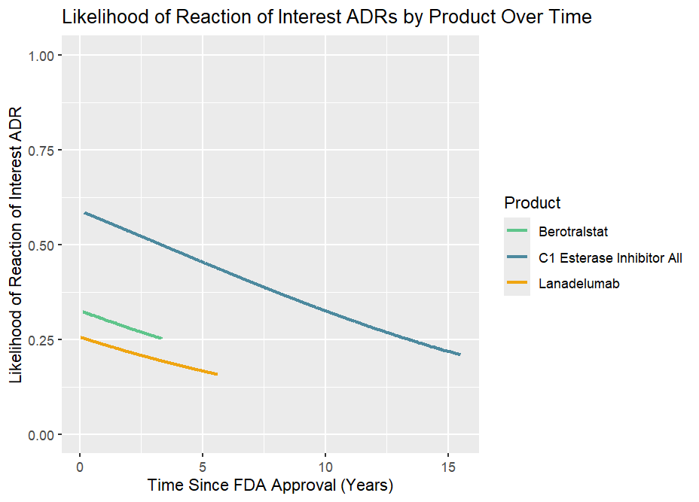
Risk of HAE ADR Reports among Products of Interest -
Adjusted for Time Since FDA Approval (from Report Date)
COMPOSITE ADR
The likelihood of all products to have a report for an ADR of interest decreases the longer the product is on the market.
CONFIDENTIAL & PROPRIETARY
- More information on the likelihood of ADR scale in Technical Notes slides

Slide 30
Main takeaways
Adverse drug reaction reports for angioedema, swelling, or lack of efficacy (combined) are more likely to have C1 esterase inhibitors as the primary suspect when compared to ORLEDAYO®
These reports were less likely to name TAKHZYRO® (lanadelumab) as the primary suspect compared to ORLEDAYO ®
These multivariate analyses were limited in the covariates available for inclusion due to a high percentage of missingness that made comparisons not possible
Additional analyses with the addition of data elements such as age and sex of the patients and their duration of therapy could alter the direction or magnitude of these results

Slide 31
MedDRA TERMS
MedDRA reaction terms lists
CONFIDENTIAL & PROPRIETARY

Slide 32
MedDRA Reaction Terms Lists
Lack of Efficacy
Condition aggravated
Decreased activity
Drug effect less than expected
Drug ineffective
Drug ineffective for unapproved indication
Drug intolerance
Drug tolerance
Drug tolerance increased
Rebound effect
Therapeutic product effect decreased
Therapeutic product effect delayed
Therapeutic product effect incomplete
Therapeutic product ineffective
Therapeutic response decreased
Therapeutic response shortened
Therapeutic response unexpected
Therapy non-responder
Therapy partial responder
Treament non-compliance
Treatment failure
Drug effect decreased
Drug effect delayed
Drug effect incomplete
Angioedema
Hereditary angioedema
Hereditary angioedema with C1 esterase inhibitor deficiency
Hereditary angioedema with normal C1 esterase inhibitor
Angioedema
Indiopathic angioedema
Swelling
Brain oedema
Breast swelling
Choking
Circumoral oedema
Circumoral swelling
Dysphagia
Ear swelling
Eye swelling
Eyelid oedema
Face oedema
Gastrointestinal oedema
Generalised oedema
Genital swelling
Gingival swelling
Intestinal swelling
Joint swelling
Laryngeal obstruction
Laryngeal oedema
Lip oedema
Lip swelling
Localised oedema
Lymhoedema
Macular oedema
Mouth swelling
Mycoardial oedema
Nasal oedema
Non-pitting oedema
Oedema
Oedema genital
Oedema peripheral
Oesophageal oedema
Oropharyngeal discomfort
Oropharyngeal pain
Oropharyngeal swelling
Palatal swelling
Papilloedema
Penile swelling
Periorbital oedema
Periorbital swelling
Peripheral swelling
Pharyngeal oedema
Pharyngeal swelling
Post procedural swelling
Pulmonary oedema
Respiratory tract oedema
Scrotal swelling
Skin oedema
Skin swelling
Swelling
Swelling face
Swelling of eyelid
Swollen tongue
Testicular swelling
Throat tightness
Tongue oedema
Upper airway obstruction
Vulvovaginal swelling
Administration site swelling
Catheter site swelling
Tracheal obstruction
Oedema mouth
Local swelling
Abdominal distension
Abdominal pain
Abdominal pain upper
Abdominal discomfort

Slide 33
TIMELINE
Project timeline review & next steps
CONFIDENTIAL & PROPRIETARY

Slide 34
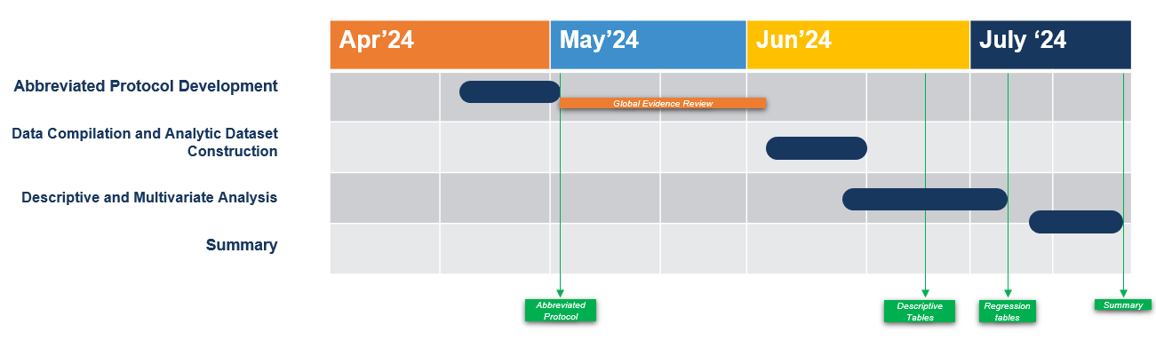
Project Timeline
• Bullets here for supporting points
• Supporting point 1
• Supporting point 2
• Supporting point 3
Deliverable/Milestone | Responsible Party | Dates/Deadline | Status
Abbreviated protocol development | Herspiegel Team | April 24-May 9 | Completed
Abbreviated protocol delivered | Herspiegel Team | May 9 | Completed
Review of abbreviated protocol and Global Evidence Review | BioCryst Team | May 9 - June 19 | Completed
Data compilation and analytic dataset construction | Herspiegel Team | June 9 - 17 | Completed
Descriptive and multivariate analysis | Herspiegel Team | June 20 - July 5 | Completed
Descriptive tables delivered | Herspiegel Team | July 8 | Completed
Review and comment on the descriptive tables | BioCryst Team | July 8 - July 22 | Completed
Regression tables delivered | Herspiegel Team | July 19
Review and comment on the regression tables | BioCryst Team | July 15 - July 22
Analysis summary delivered | Herspiegel Team | August 10
CONFIDENTIAL & PROPRIETARY

Slide 35
APPENDIX
Technical notes regarding analyses
CONFIDENTIAL & PROPRIETARY

Slide 36
Technical Notes Regarding Analyses
^ Time since FDA Approval = (Report Date – FDA Approval Date)/364.25
# NS = brand was not specified
+ FDA approval date for C1 Esterase Inhibitor (NS) was calculated as an average of approval dates for all other C1 Esterase Inhibitors
- The dependent ADR scale (y-axis) in the graphs from 0-1 is the likelihood of a report with the drug of interest having the reaction of interest in the report (1=yes, 0=no)

